Slide 1

Introduction to ReactNative
Hiran PEIRIS – ATL, TIQRI COPERATION

Slide 2
Introduction

Slide 3


What is ReactNative ?
It is a JavaScript framework.
Developed by facebook.
Its pure Native, No hidden HTML browser containers.

Slide 4
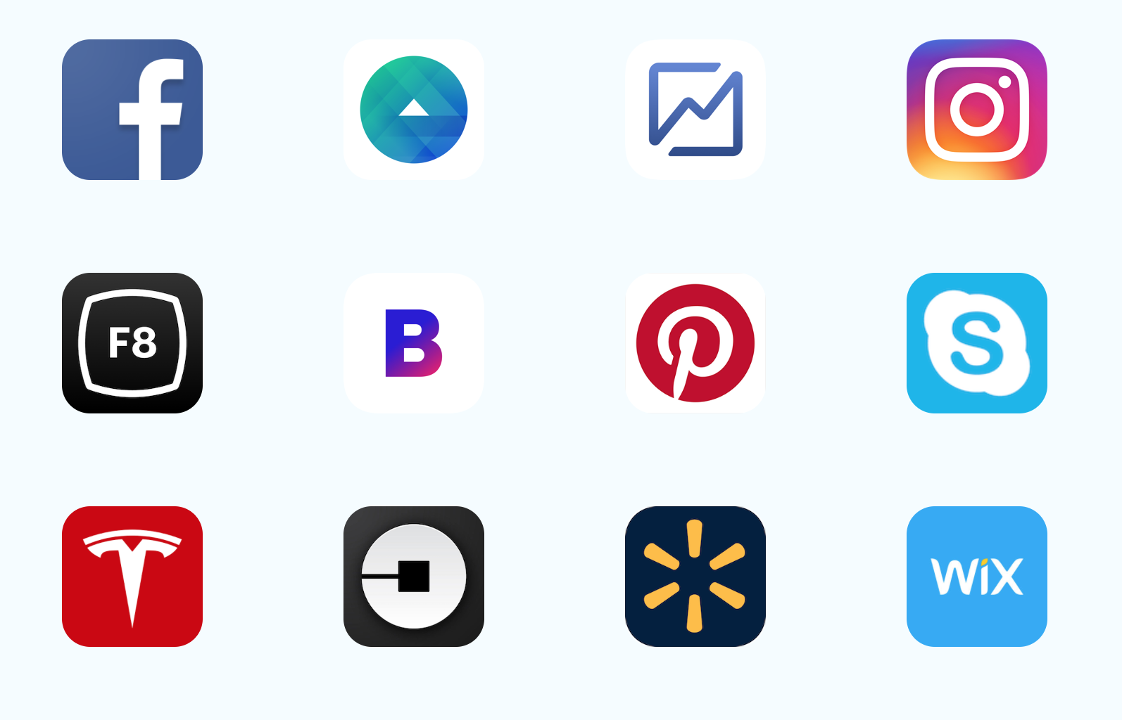
Who uses ReactNative ?

Slide 5
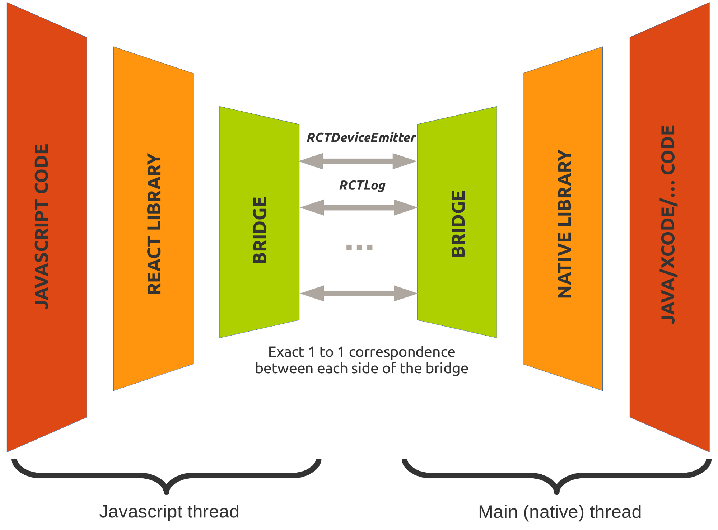
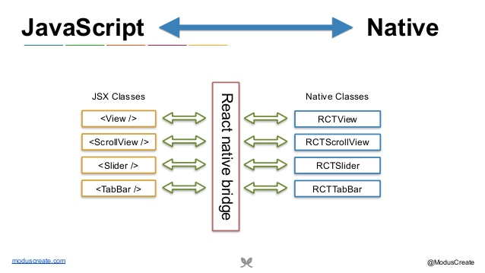
How it works ?

Slide 6
Learn more about ReactNative
https://facebook.github.io/react-native/
http://www.reactnative.com
https://reactnavigation.org
https://expo.io

Slide 7
Setting up your development environment

Slide 8
Install ReactNative
Install Node.js.
https://nodejs.org/en/download/
Install expo-cli.
npm install -g expo-cli
https://facebook.github.io/react-native/docs/getting-started

Slide 9
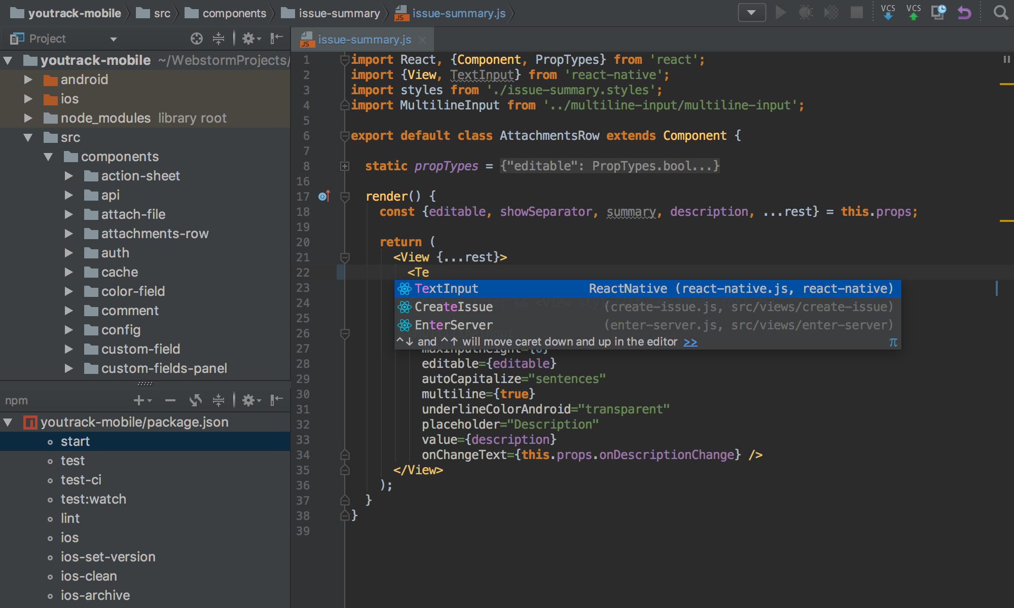
Install JetBrains WebStorm IDE
https://www.jetbrains.com/webstorm/

Slide 10
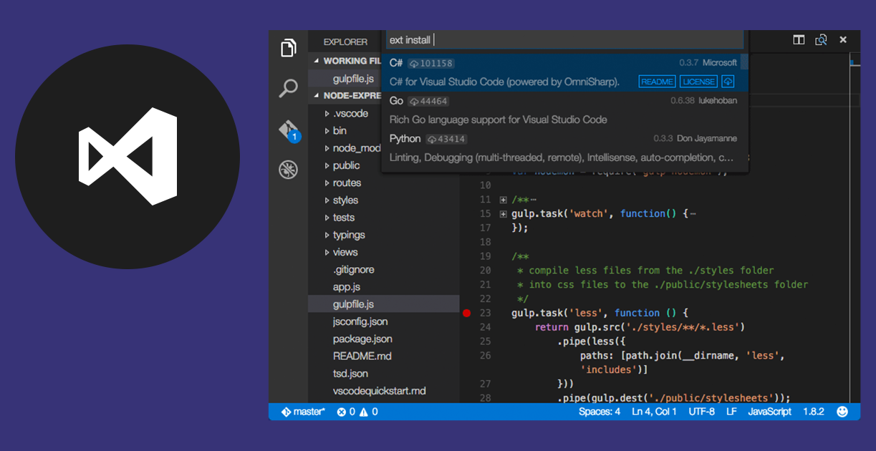
Install VS Code
VS Code. https://code.visualstudio.com
Install ReactNative support package for VS Code.

Slide 11
Create your first ReactNative App

Slide 12
Init your project
expo init AwesomeProject
cd AwesomeProject
npm start

Slide 13
What is Expo ?
Expo is the official command line tool for ReactNative.
expo-cli
With expo you can build your app in the cloud.
Cloud build
With cloud builds you can develop iOS, Android Apps in any PC.
Windows, Linux, Mac.
Expo simplifies the AppStore distribution process.

Slide 14
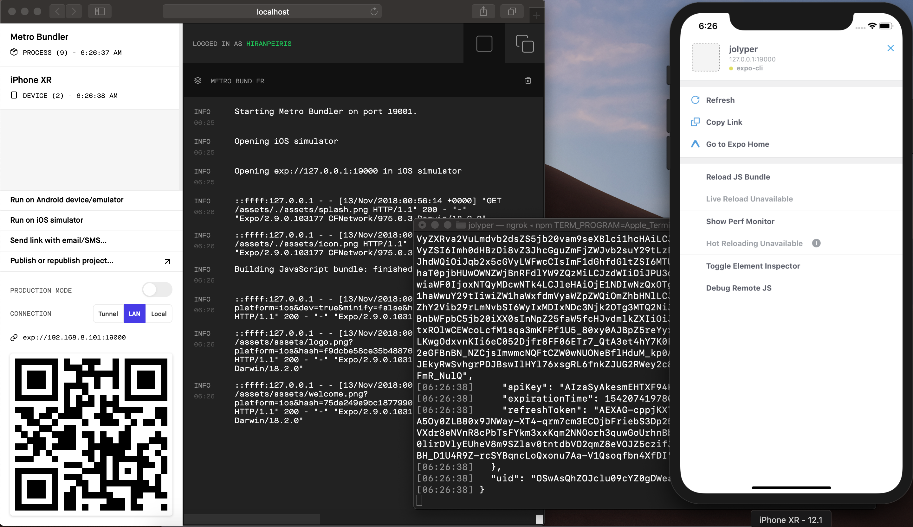
Expo livesync

Slide 15
React Components & Stylesheets

Slide 16
React Components
Built-in Components
Eg: View, Button, Text, Image and etc
Custom Component
Combination of built-in components.
Eg: <View><Text>Hello</Text></View>

Slide 17
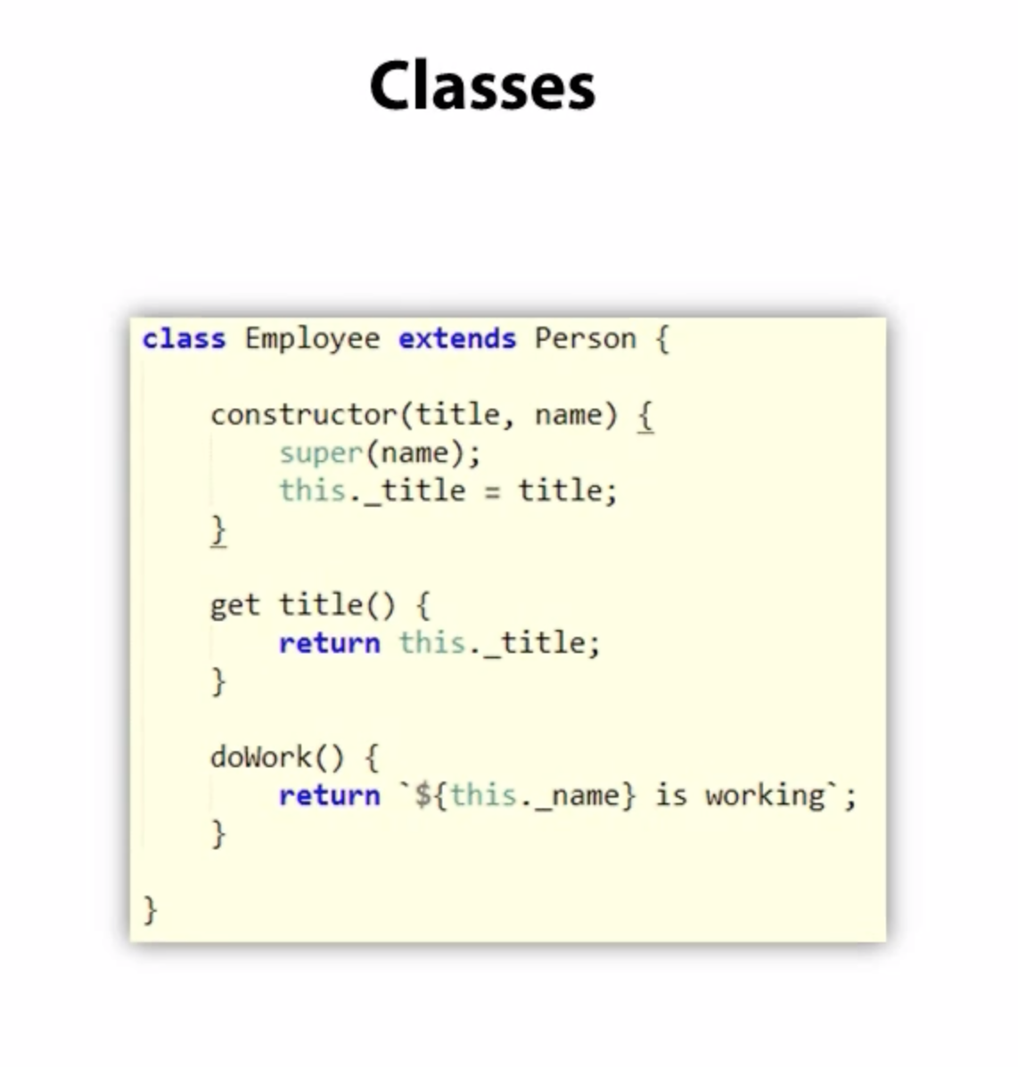
ReactNative uses JavaScript ES6

Slide 18
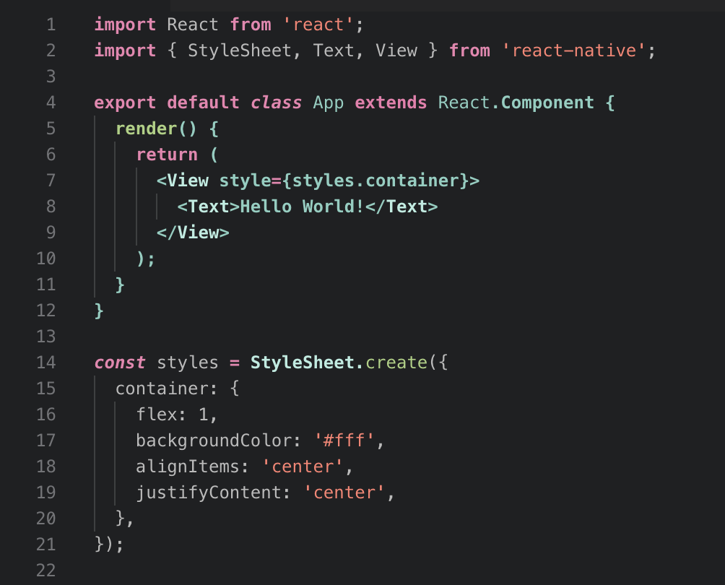
RN Component Structure

Slide 19
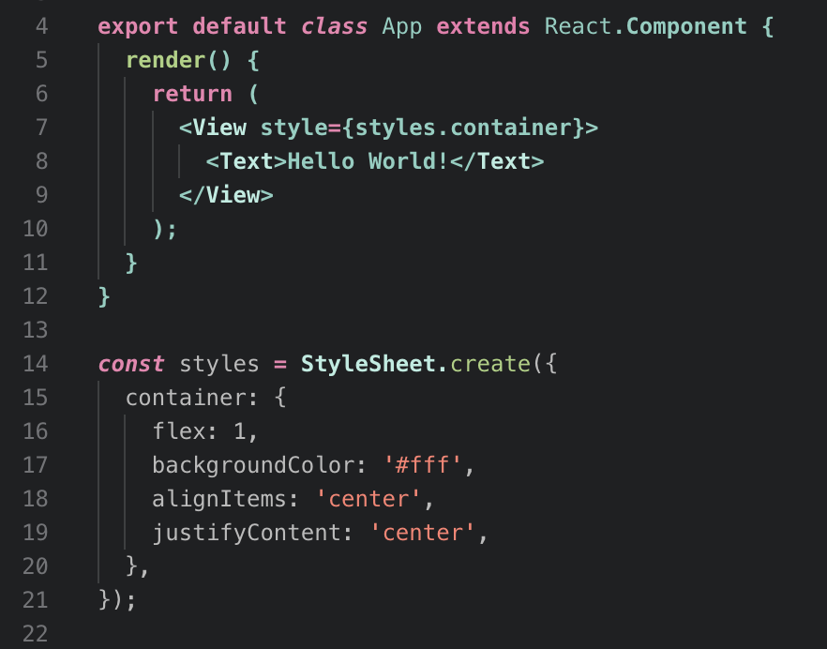
Stylesheet
Stylesheet contains layout configurations and properties of RN Component.

Slide 20
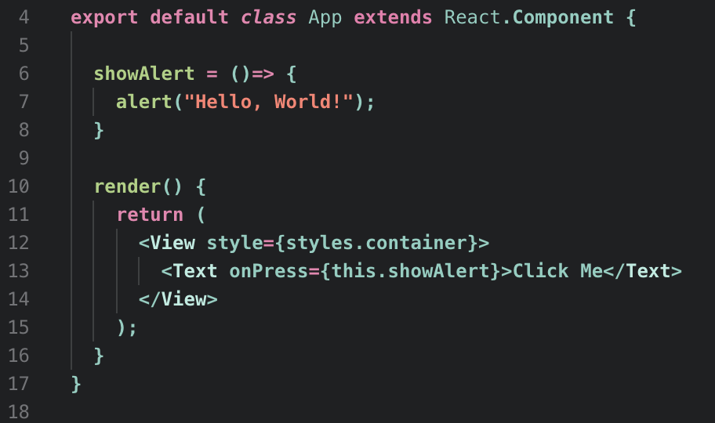
Event Handlers

Slide 21
Navigation between pages

Slide 22
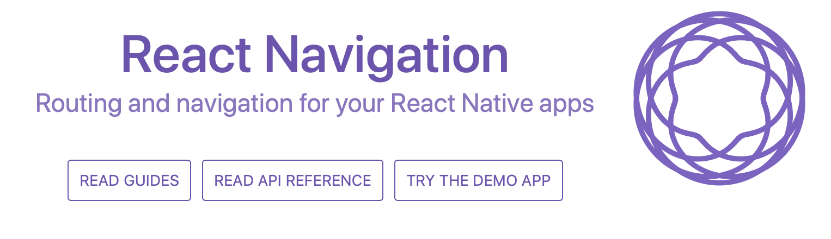
ReactNavigation
https://reactnavigation.org
npm install --save react-navigation

Slide 23
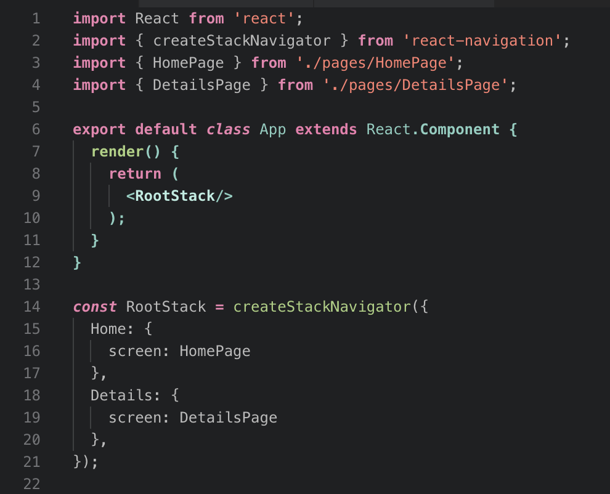
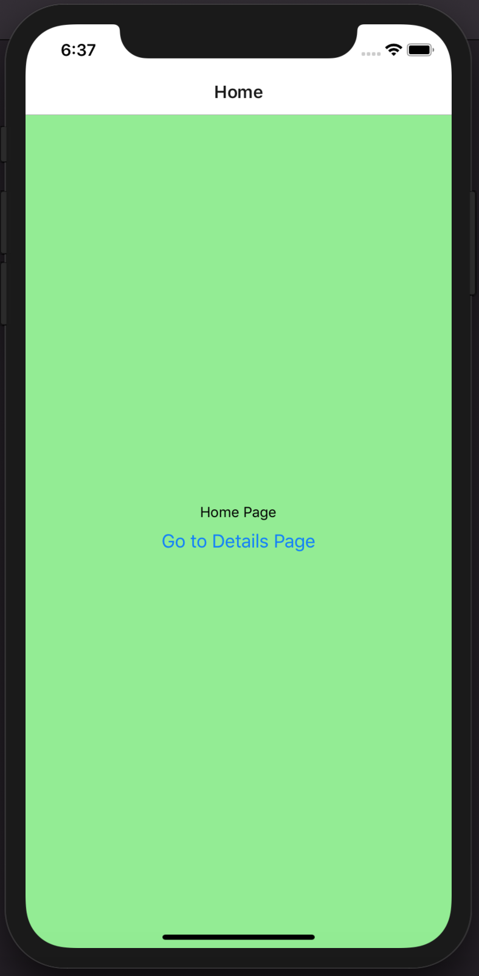
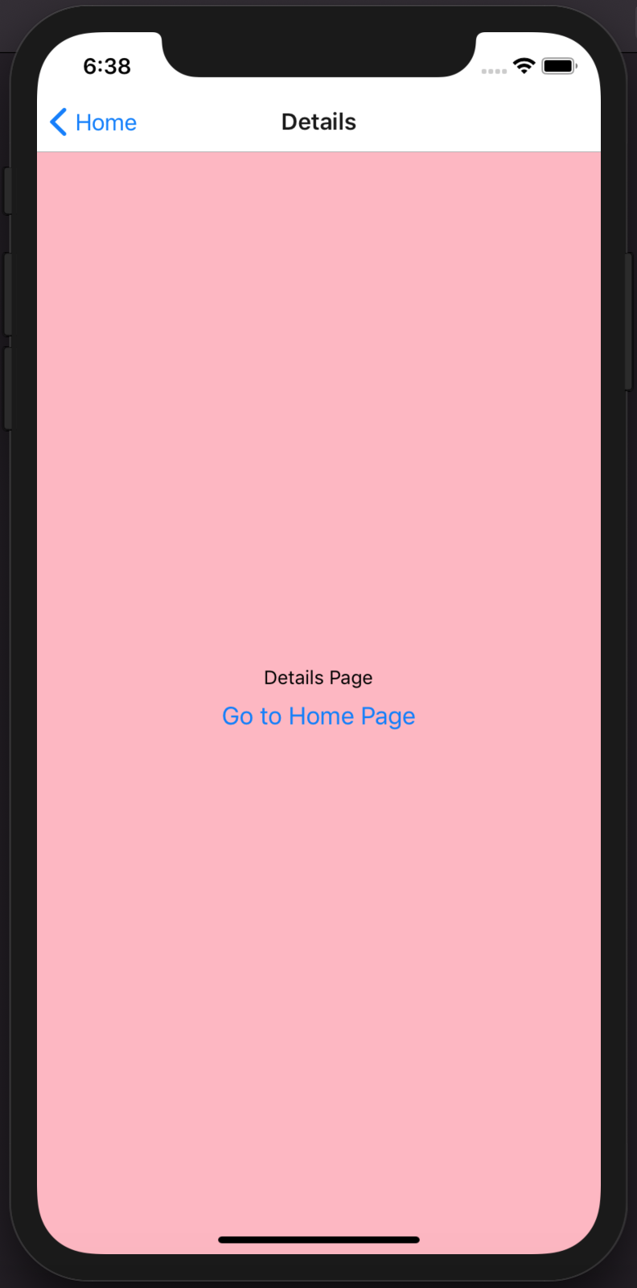
Stack navigator
Navigate between pages

Slide 24
Data binding with RN State

Slide 25
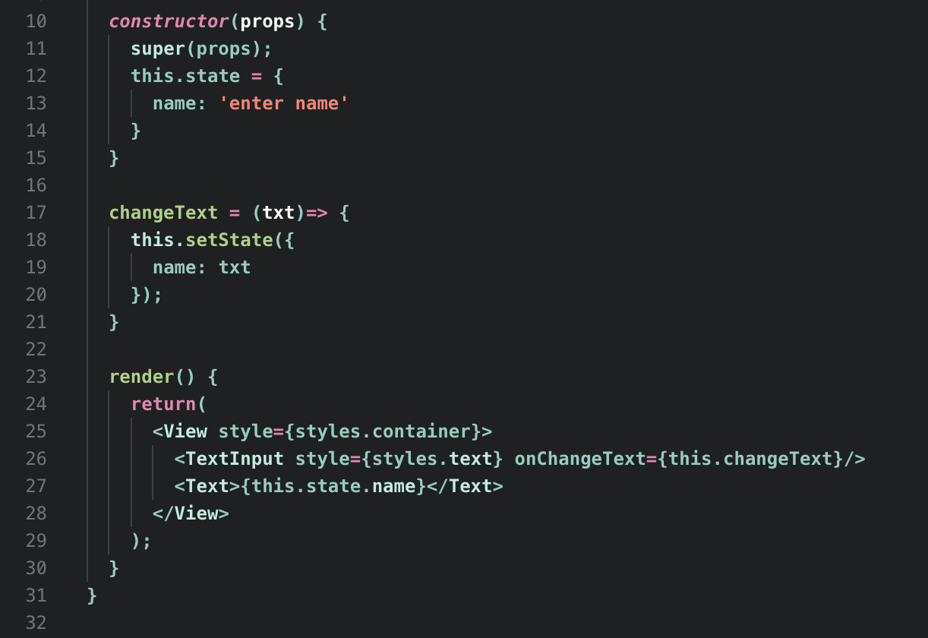
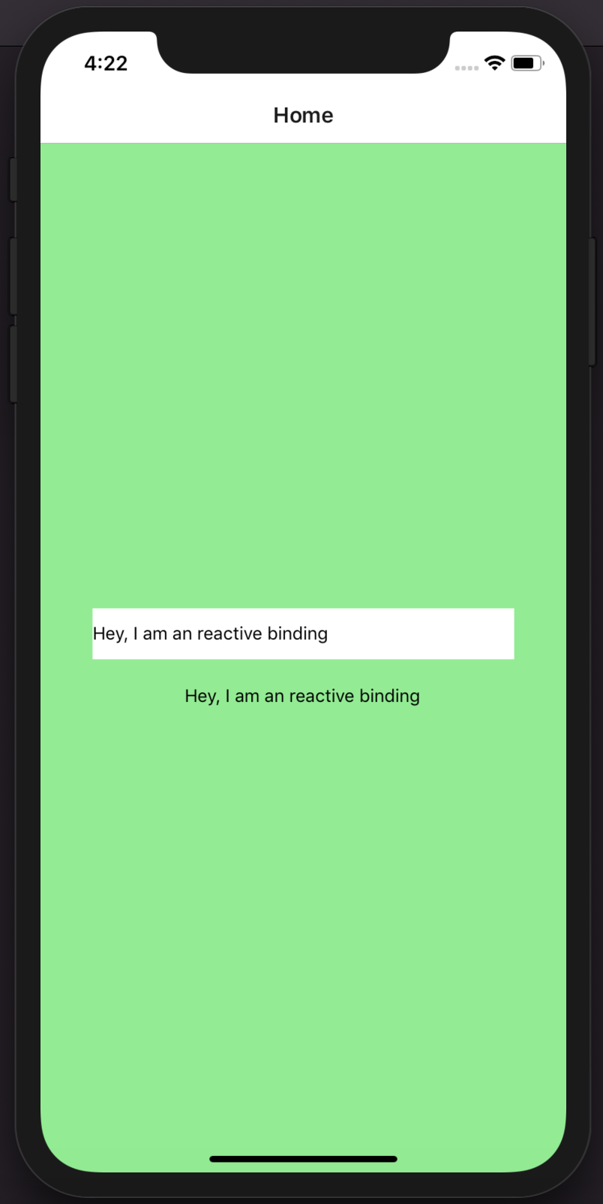
What is RN State
State is a class member which is used for reactive data binding.

Slide 26
Deploy your RN App with Expo

Slide 27
Build on Expo cloud
iOS
expo build:ios
Android
Expo build:android
https://docs.expo.io/versions/v31.0.0/distribution/building-standalone-apps

Slide 28
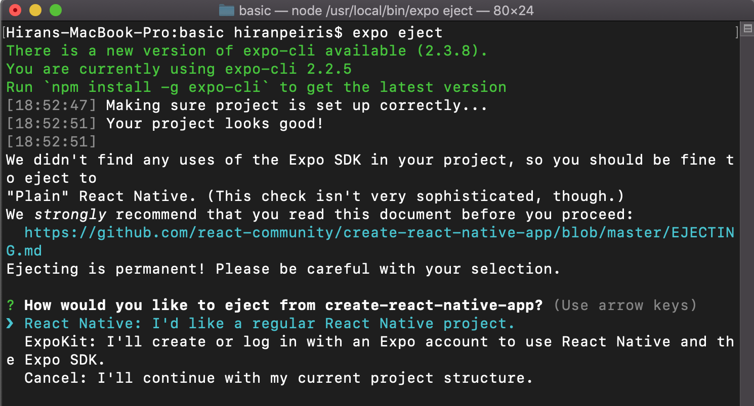
Build Local
expo eject

Slide 29
Q/A

Slide 30
Thank you… ☺

